Slide 1
Mastering the Marketplace
Michelle Ho - Partner Development Manager
Wai Man Hui - Cloud Solution Architect

Slide 2
Agenda
Opportunities with marketplace
Partner's Marketplace Journey & Experience
Introduction of different offer types
Getting started and Marketplace Incentives
Q&A

Slide 3
Opportunities with marketplace

Slide 4
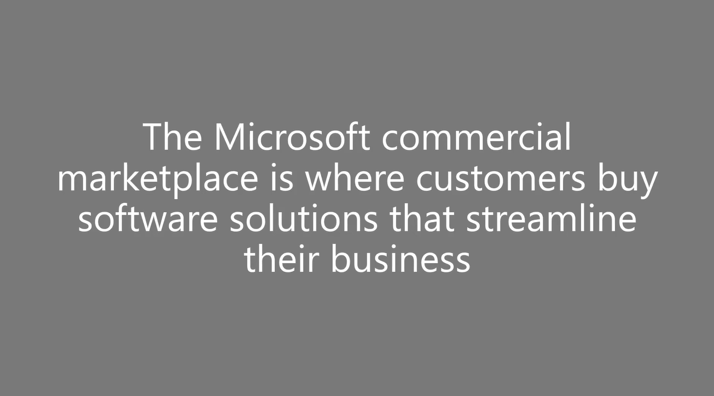

Slide 5
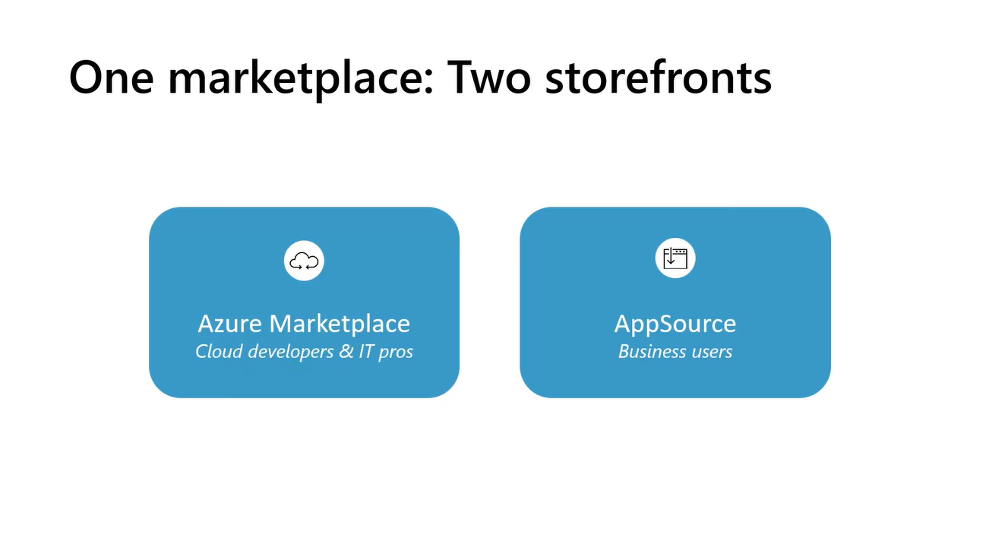

Slide 6
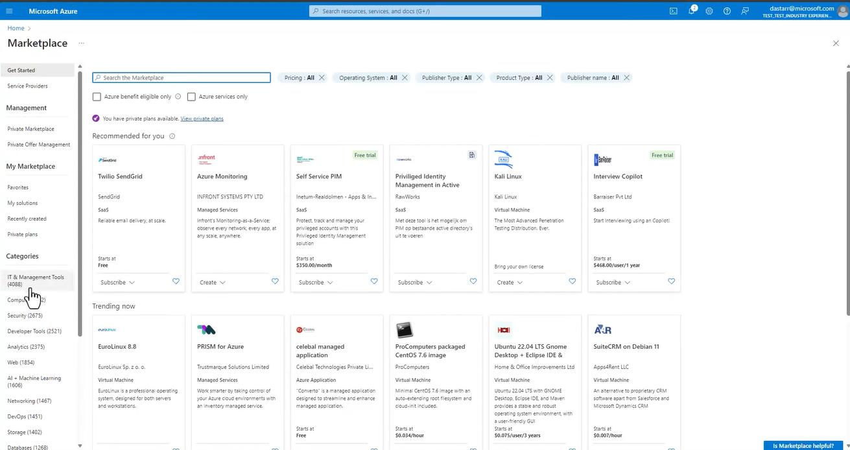

Slide 7
How marketplace deals originate
Partner initiated - partner initiates the deal, sales team may help with late-stage tactical questions
Customer initiated - customer seeks to fulfill a MACC, seller and PDM collaborate to involve partner
Seller initiated – seller proactively recommends a solution, customer transacts custom deal

Slide 8
Growth imperatives top of mind for every ISV today
1
Build differentiated product portfolio
Product market fit
3
Drive adoption & sales growth
Market value fit
2
Launch them in market

Slide 9
With cloud investments growing, buying roles expanding to multiple teams
BDM / LoB
Needs: Flexibility and speed to solve business problems
Procurement / buying office
Needs: Governance, spending optimization
IT Admin
Needs: Meet the needs of the organization, securely
Microsoft commercial marketplace

Slide 10



95% of Fortune 500 use Azure, majority use marketplace to manage cloud portfolio
Other marquee marketplace customers in key industries:

Slide 11
Microsoft commercial marketplace: accelerating B2B tech commerce
Build
Purchase
Publish
Deploy
Advocate
Reach customers
Increase efficiency
Engage
Customers | Partners | Sellers
Simplify sales
Buy confidently
Unlock growth
Spend smarter
Partners
Customers

Slide 12
Partner Journey through Microsoft Marketplace

Slide 13
Partner Journey through Microsoft Marketplace
Partner Center Set-up
Add publishers in the Commercial Marketplace
Complete the Partner Center account verification
Accept the Microsoft Publisher Agreement
Update the Tax and Payment Profile
Offer Creation
Determine offer type based on your solution and pricing - SaaS - Azure Managed Application - Azure Container - Azure Virtual Machine
Post – Publish Journey
Update Co-Sell documents including the Reference Architecture Diagram
Private Offer/Custom deals
Insights - Invoice, Payouts
Incentives and Rewards
Build offer in Partner Center
Technical Integration
Update plans and pricing
Publish, test and Go Live
Configure Partner Center Account

Slide 14
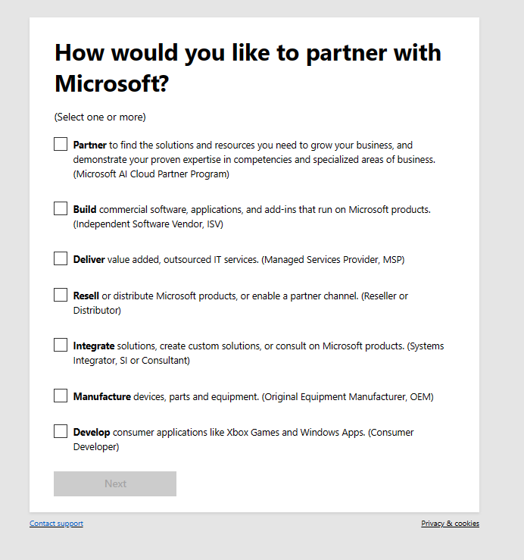
Get started with Partner Center
Introduction (microsoft.com)

Slide 15
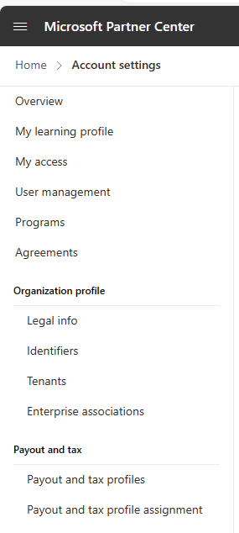
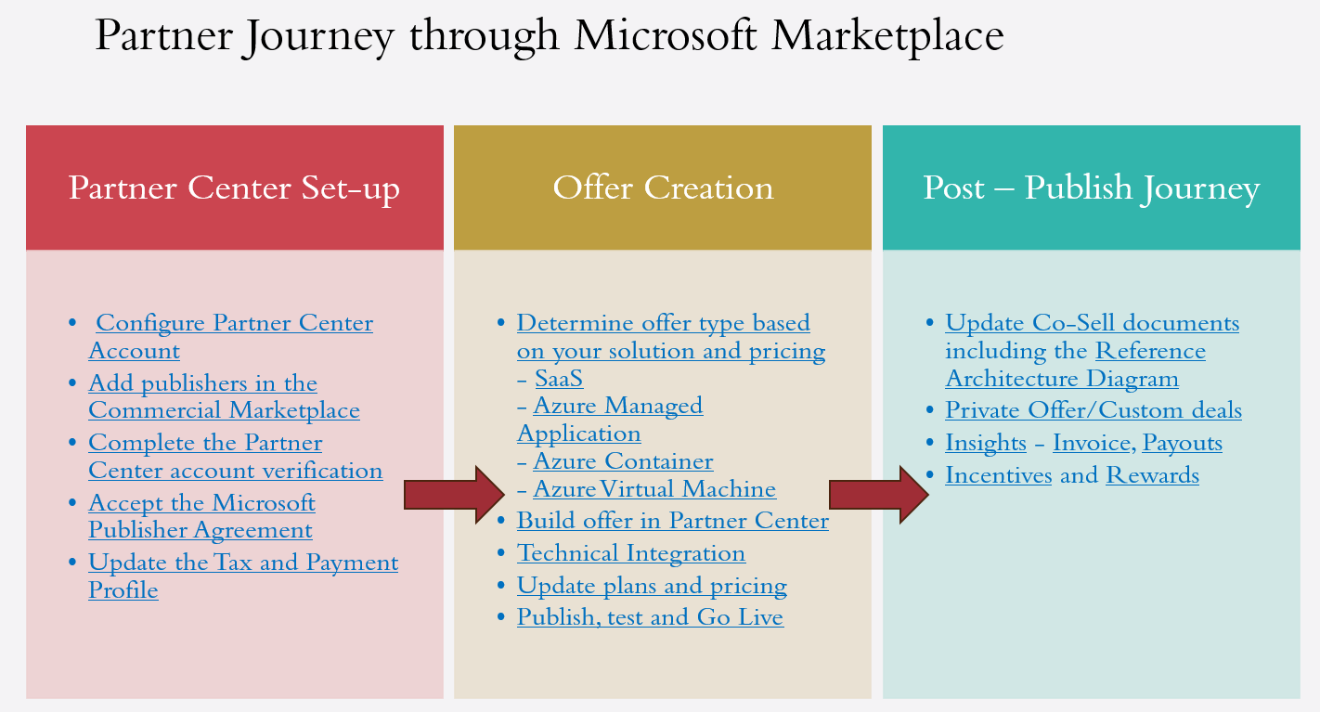
Pre-requisites for publishing an offer

Slide 16
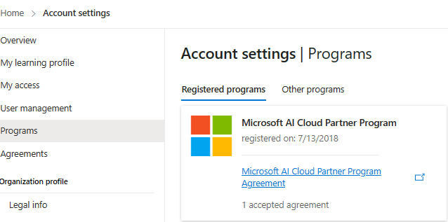
Sign up and accept the agreement

Slide 17
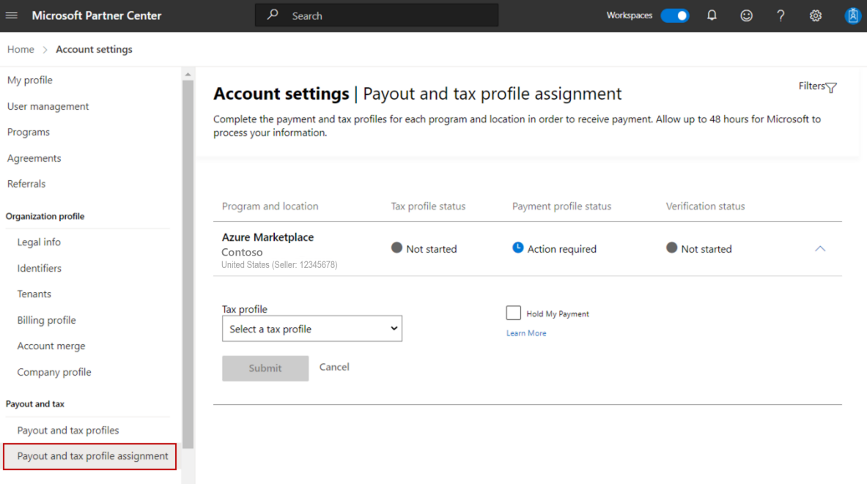
Tax and Payout profile

Slide 18
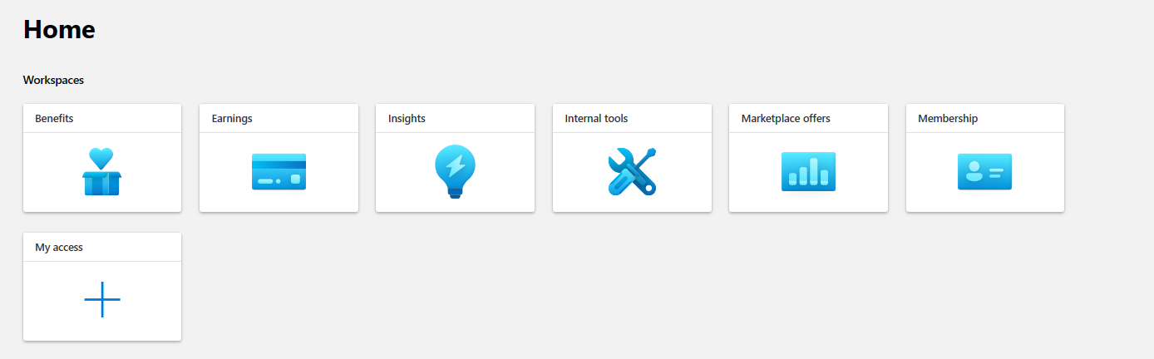
Lets get started…

Slide 19
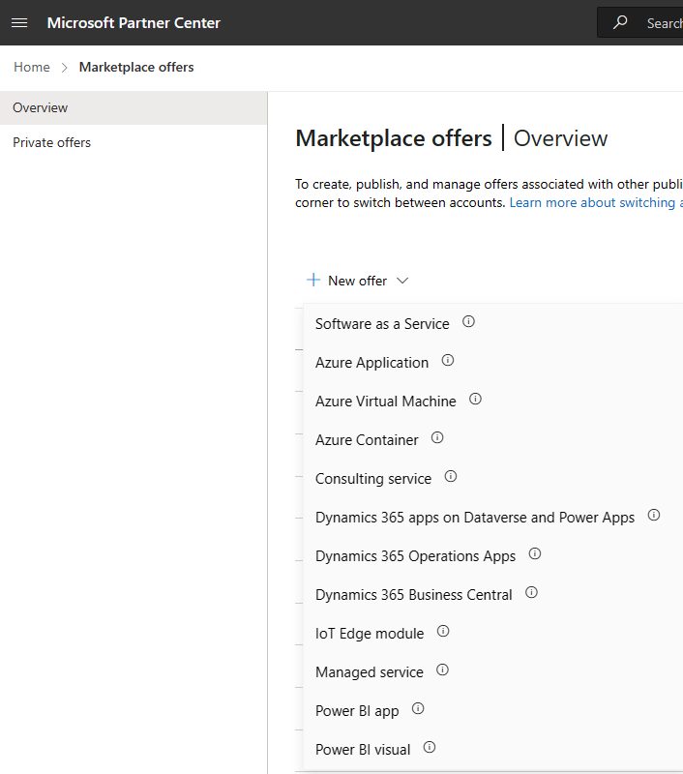
Select the offer

Slide 20
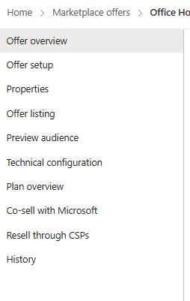
Standard across all offer types
CRM
Storefront and legal
Technical configuration and plans/pricing differs for every offer – aka.ms/MTMSP
Marketing
Sandbox
Price
Will be updated after the offer is live
If you have an established relationship with Microsoft Sellers - CSP

Slide 21
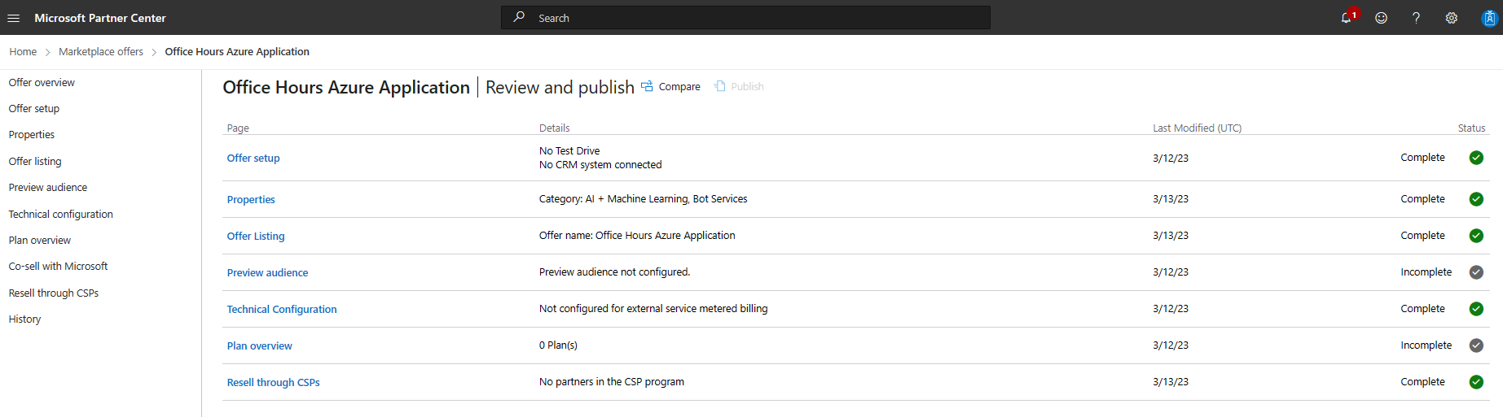
Check in

Slide 22
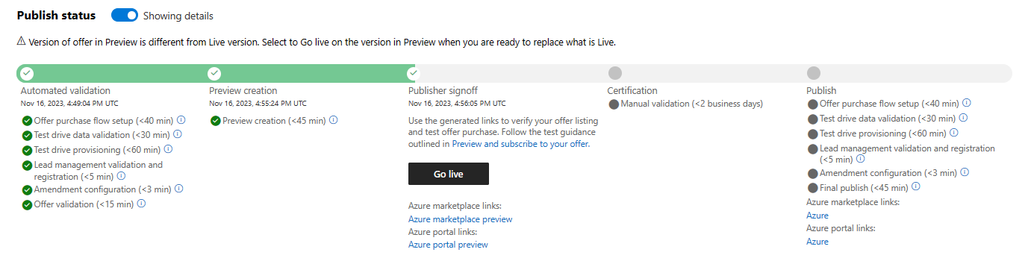
Publish, Test and Go live

Slide 23
Introduction of different Marketplace offer types

Slide 24


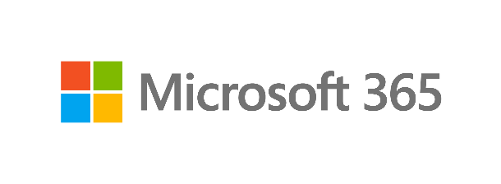



Commercial marketplace delivers the best apps to customers 24/7
Publish your app
to surface in…
Industry applications
Line of business applications
Productivity applications
Category and workload building blocks for Azure
Microsoft AppSource
Azure Marketplace

Slide 25

Marketplace Rewards | Earn more GTM benefits the more you transact
List
Trial
BYOL
Transact
Contact Me
lead generation for all commercial marketplace solutions
Trial
demonstrate your solution’s capabilities and convert your customers faster
BYOL
for customers to quickly deploy your offer
Get It Now
for customers to buy and deploy your offer: unlock a whole new realm of benefits
Offer launch support
Configure lead management
Offer launch support
Configure lead management
Social promotion
Offer launch support
Configure lead management
Social promotion
Rapid application deployment
Offer launch support
Configure lead management
Social promotion
Marketplace Rewards benefits
Rapid application deployment
Inclusion on Microsoft price list
Standard contracts
Consolidated customer billing
For qualified offers:
Incentives for Microsoft resellers (CSP)
Benefits

Slide 26
Offer types and Listing
Introduction to listing options - Microsoft commercial marketplace - Marketplace publisher | Microsoft Learn
Offer types and add-ins | Contact Me | Free Trial | Get It Now (Free) | BYOL | Get It Now (Transact)
Azure Virtual Machine |  |  |  | Azure Marketplace | Azure Marketplace
Azure Application |  |  | Azure Marketplace | Azure Marketplace | Azure Marketplace
Azure Container |  |  | Azure Marketplace | Azure Marketplace | Azure Marketplace
IoT Edge module |  |  | Azure Marketplace | Azure Marketplace
Managed service |  |  |  | Azure Marketplace
Consulting service | Both online stores
SaaS | Both online stores | Both online stores | Both online stores |  | Both online stores
Microsoft 365 App | AppSource | AppSource |  |  | AppSource
Dynamics 365 Business Central | AppSource | AppSource
Dynamics 365 apps on Dataverse and Power Apps | AppSource | AppSource |  |  | AppSource
Dynamics 365 Operations Apps | AppSource | AppSource
Power BI App |  |  | AppSource

Slide 27
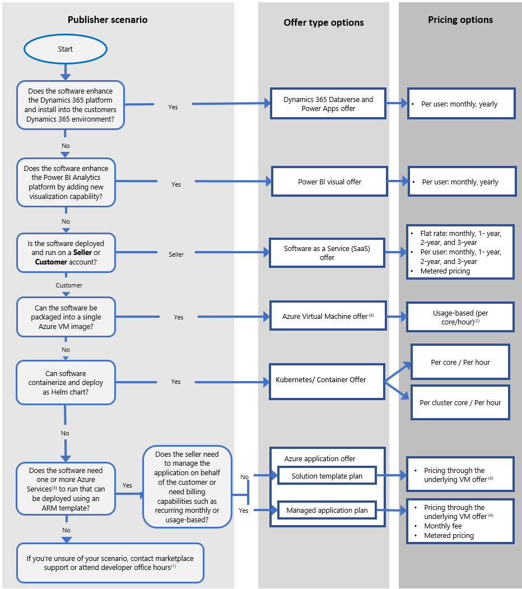
Transactable Offers
Offer type | Billing cadence | Metered billing | Pricing model
Azure Virtual Machine | Monthly and upfront | No | Usage-based, BYOL
Azure Container (Kubernetes App) | Monthly | No | Usage-based, BYOL
Azure Application (Managed application) | Monthly | Yes | Usage-based and flat rate
Software as a service (SaaS) | One-time upfront monthly, annual | Yes | Flat rate, per user, usage-based.
Microsoft commercial marketplace transact capabilities - Marketplace publisher | Microsoft Learn

Slide 28
Transactable Offers
Metered billing
Allow specifying pay-as-you-go (consumption-based) charges in addition to monthly or annual charges
Billing infrastructure costs
Virtual Machines, Containers
Billed to the customer's Azure subscription
Priced and presented separately from the software provider's licensing fees on the customer's invoice
Azure applications
Billed to the customer's Azure subscription
Support billing to the publisher if configuring a managed app plan for ISV infrastructure charges
SaaS Apps
Azure infrastructure usage is managed and billed to the publisher directly
Publishers typically opt to bundle Azure infrastructure usage fees into their software license pricing

Slide 29
Pricing Models
Subscription pricing
Software license fees are presented as a recurring subscription fee billed as a flat rate or per-license:
SaaS plans support monthly, 1-year, 2-year, and 3-year terms that can be billed either monthly or for the entire term upfront
Azure virtual machine plans support 1-year, and 3-year reservation pricing that are either billed upfront or monthly
Azure application (Managed application) plans are billed monthly
Usage-based pricing
For Virtual Machine images and Container offers, customers are charged an hourly Azure Marketplace fee, as set by the publisher
Partial hours are charged on a per minute basis. Plans are billed monthly
The hourly fee can be uniform or varied across virtual machine sizes
Metered pricing
For Azure Application offers and SaaS offers, publishers can use the Marketplace metering service to bill for consumption based on the custom meter dimensions they configure
Examples of custom meter dimensions are bandwidth, tickets, or emails processed.
Publishers can define one or more metered dimensions for each plan but a maximum of 30 per offer.
Publishers are responsible for tracking individual customer usage, with each meter defined in the offer.
Events should be reported to Microsoft within an hour of occurrence. Microsoft charges customers based on the usage information reported by publishers for the applicable billing period

Slide 30
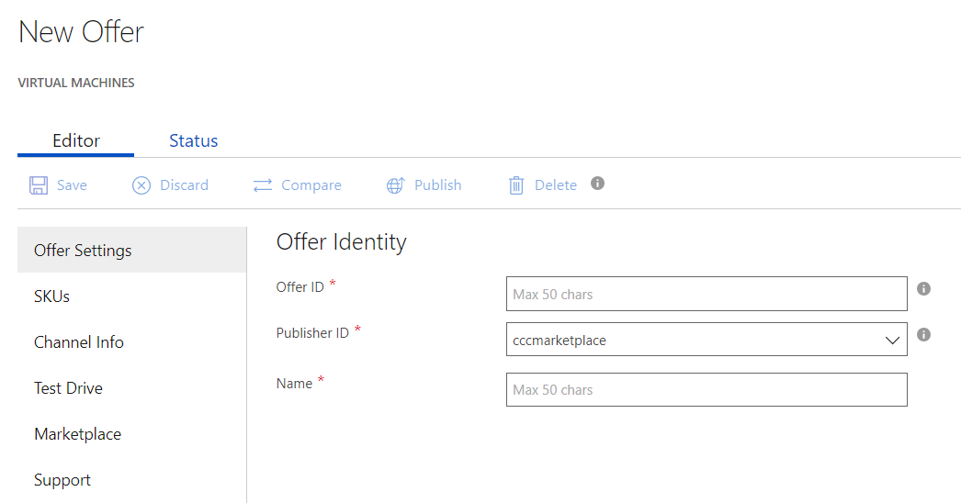
Virtual Machine Offer
One Virtual Machine
The VM offer provides you a simple way to deliver a solution in one single Virtual Machine
Partner Center
Build the offer in Cloud Partner Center. Soon to be migrated to the Partner Center
Simple Billing Model
VM offer supports BYOL and Transact. Solution is billed as Per Core/Hour/Month

Slide 31
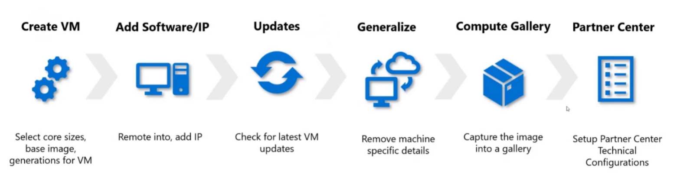
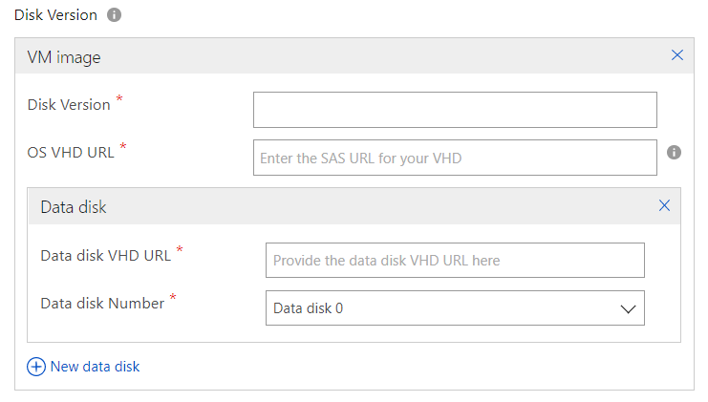
VM Offer Technical Assets
Building the VM Image
Build the VM Image that will be used as a base for the Offer. You can use an MS Stock image or build your own custom image
Open Ports
Define the Open Ports you want to have in the Offer
(Optional) Data Disk Images
For each VM, you can attach up to fifteen (15) Data disks

Slide 32
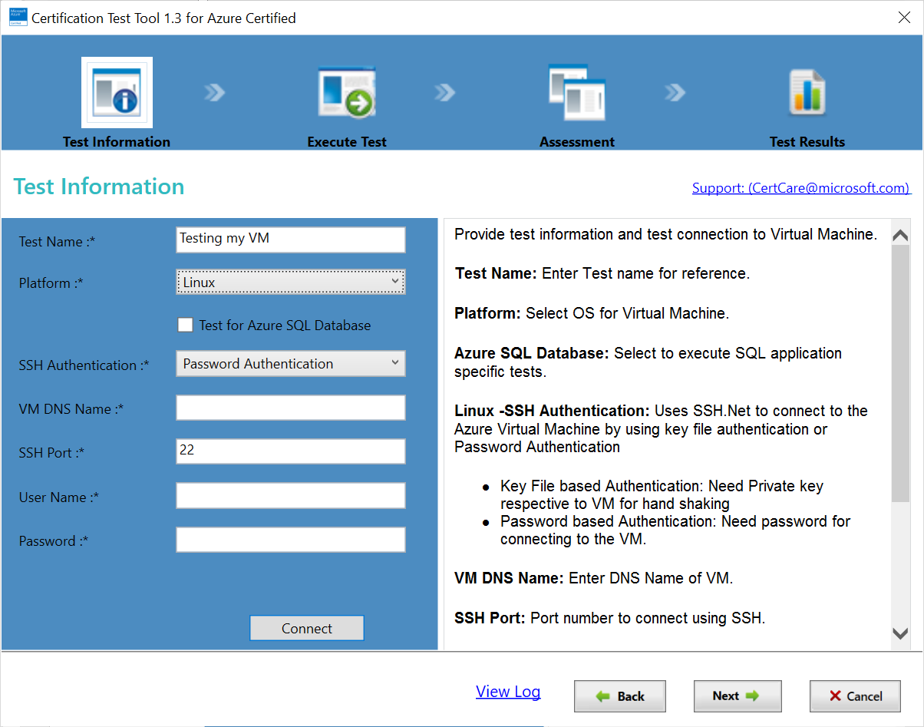
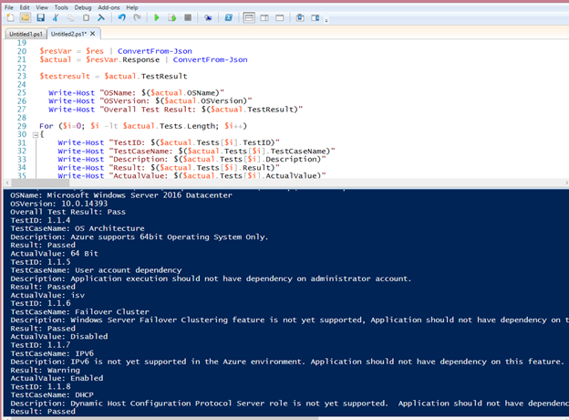
Run a certification test
Certification Test Tool
Windows OS
Self-Test API with PowerShell or Curl
Windows OS
Linux OS

Slide 33
Virtual Machine Publishing
Creating the Offer
This is where all the details and information about the offer is configured. This includes the offer description, SKUs, marketing materials, legal, support information and assets.
Creating the Technical Assets
This is where we create the technical assets for the Virtual Machine. Building of the VM and associated Data drives.
Publishing the offer
Once the offer is submitted, the publishing process, in which the solution template is tested, validated, certified and approved for publishing.

Slide 34
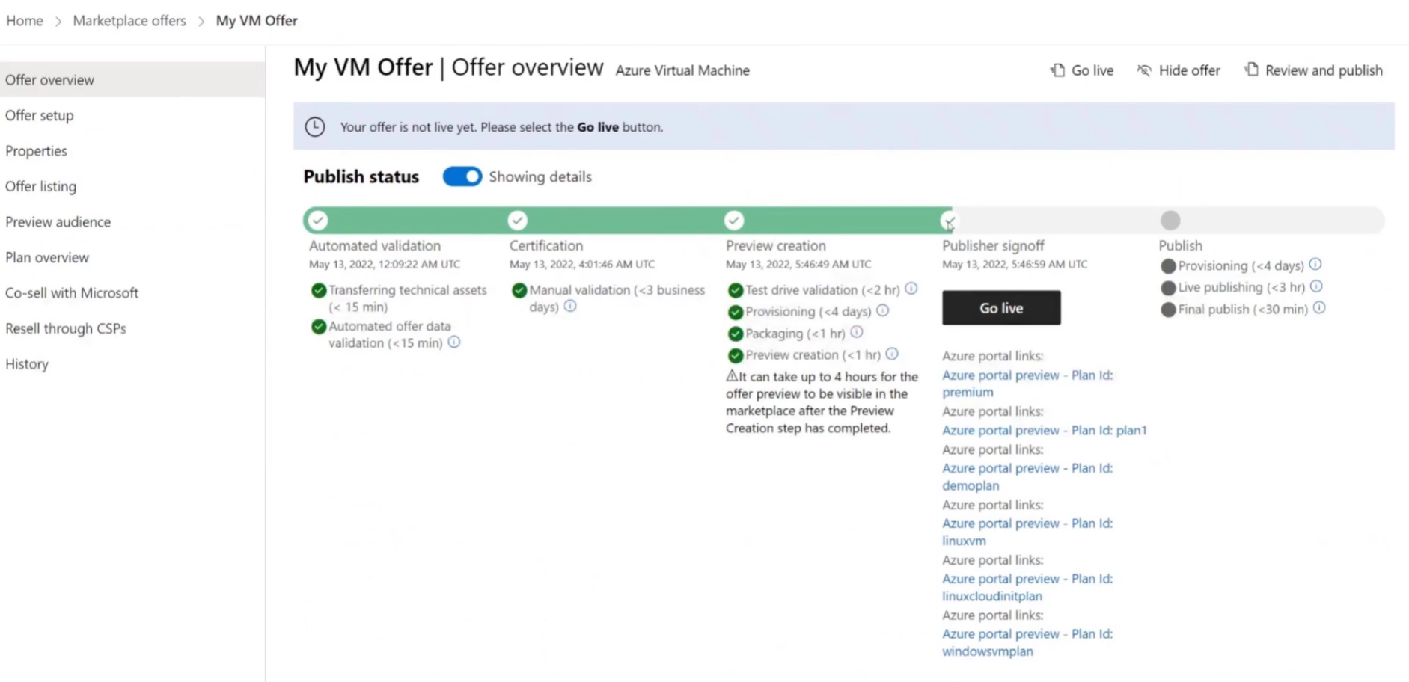
Publishing the Offer

Slide 35
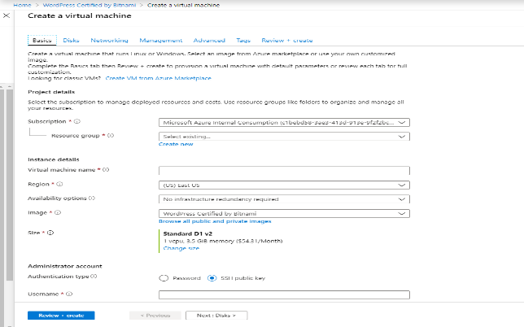

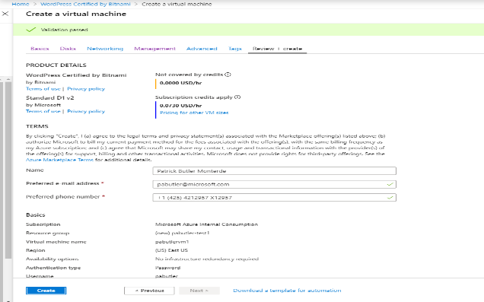
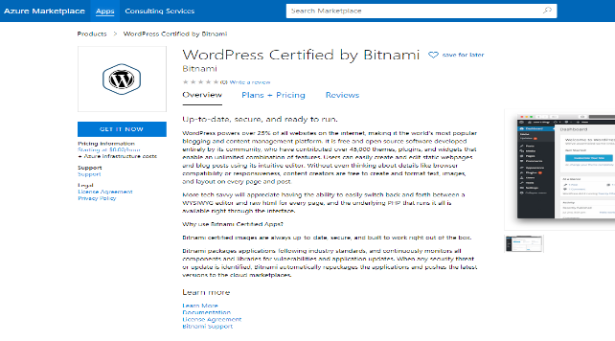

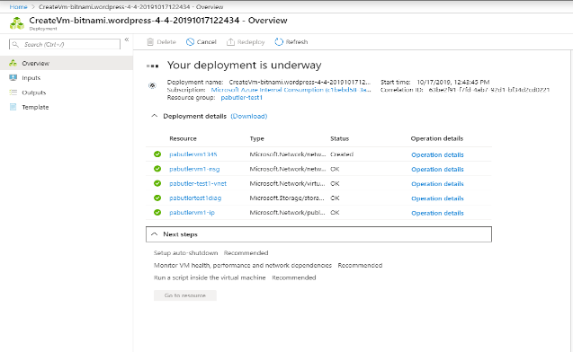
Customer VM Offer Purchase Experience
Azure AD
Azure Portal
5
5.1 Select the Resource Group
5.2 Select Disks, Networking, Management
5.3 Select Advanced features and Tags
5.4 Review and Create the Virtual Machine
Validate Identity
4
Azure Portal
6
Azure Portal calls Marketplace to Deploy VM Offer
Validate Identity
3
Create Offer
In Azure Portal
2
Azure Marketplace
7
CUSTOMER
Azure Portal
VM Offer is deployed in
Azure Portal
1
Purchase Offer

Slide 36
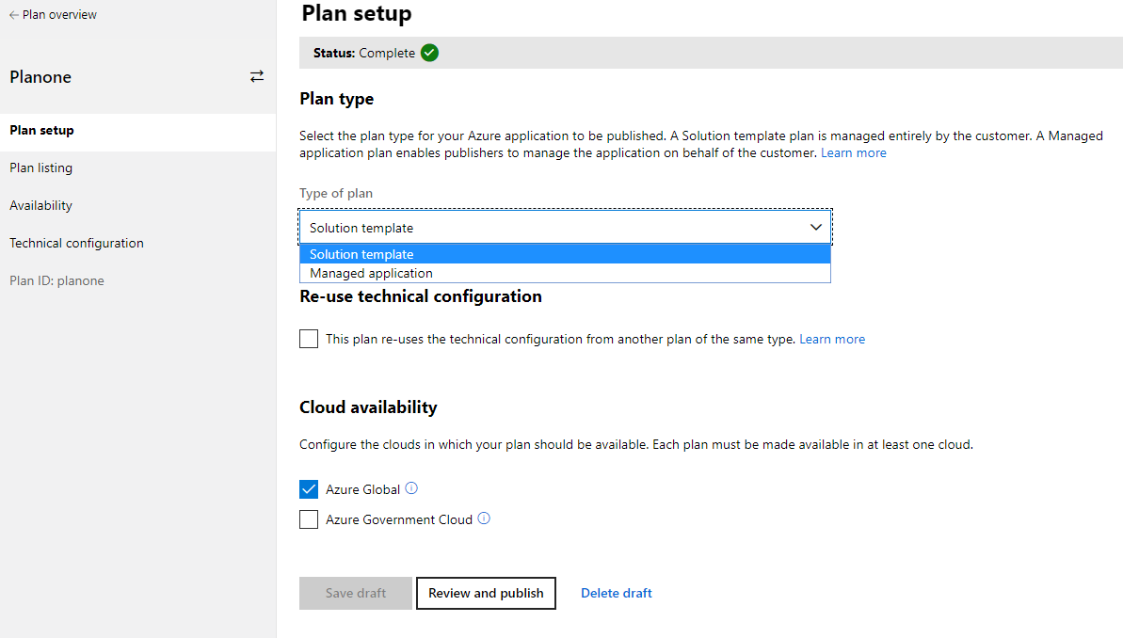
Azure Applications Offer
Complex Solutions
The VM offer provides you a simple way to deliver a solution in one single Virtual Machine
Solution Templates & Managed Applications
In Partner Center, Azure Applications includes both Solution Templates and Managed Applications
Different Billing Models
Solution Templates: BYOL and can be monetized via VM Offers. Azure Applications have: BYOL, Per Month flat fee and Metered Billing (on beta)

Slide 37
Azure Applications
Deployed using ARM templates
Resources deployed to customer subscription
Solution Template Plan
Managed Application Plan
Can be transactable when transactable VM offer is included
Customer manages resources in their own subscription
Transactable offer type
Deployed Azure resources costs + additional recurring pricing and usage costs
Publisher manages resources in customer subscription

Slide 38
Solution Template Publishing
Creating the Offer
This is where all the details and information about the offer is configured. This includes the offer description, marketing materials, legal, support information and assets.
Creating the Technical Assets
This is where we create the technical assets for the Solution Templates. Building of the VMs, the Portal UI, the ARM templates and the Solution package itself.
Publishing the offer
Once the offer is submitted, the publishing process, in which the solution template is tested, validated, certified and approved for publishing.

Slide 39
Solution Template Offer: Development Lifecycle
Determine the Azure Services
Required
Define the Environment Information
Iterate through
the Offer Artifacts
Create the Publishing Package
Determine Azure Services
Define Data Fields
(Parameters)
Build
Build Zip File
Upload to the
Partner Center
Test Templates
Create
Template
Params
Build
UI Mockups
Create Fields, Types and Filters
Deploy
Test

Slide 40
Solution Template Offer Technical Artifacts
User Interface (CreateUiDefinition)
This is where all the detail and information about the offer you need from the customer is defined
Deployment Template (Azure Resource Manager Template)
This is where we define the Azure Infrastructure that will support the Offer
(Optional) Artifacts
The offer may have a need to include configuration scripts, libraries and runtimes
(Optional) Artifacts – VM Images
Custom VM images can be build using the VM Offer and then utilize in Azure App templates (solution templates and managed applications)
User Interface
Azure Portal
User Experience
Azure Resource Manager Template
Infrastructure as Code
VM Images References
Artifacts
(Optional)
Libraries
Scripts
Nested Templates
Offer’s Technical Assets Package
(Package.zip)

Slide 41
Developing the Solution Template Artifacts
Develop Resource Manager Artifacts
Develop UI Experience
Incremental Template Development
Build
Start with an Azure Quickstart Templates
Use Visual Studio Code with the Azure Resource Manager plugin
Test
Run the Template Validation Tool
Run the Deployment script
Debug
Review Validation Tool Output
Review the Deployment Output
Repeat
Repeat (Until Done)
Incremental Create UI Development
Build
Start with an Azure QuickStart Template
Use Visual Studio Code with JSON Support
Test
Run the CreateUIDefinition Validation Script
SideLoad CreateUIDefinition in the Azure Portal
Debug
Review Validation script Output
Repeat
Repeat (Until Done)

Slide 42
Azure Services supported by Solution Templates Offers?
Azure Marketplace supports most of the 200+ Azure Services
Azure QuickStart Templates provide more than 700+ examples that you can use as a base to build your Offer
https://github.com/Azure/azure-quickstart-templates

Slide 43
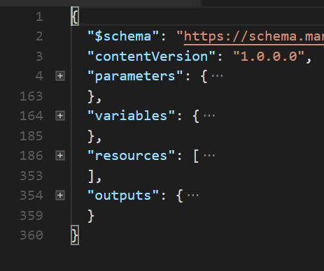
What is an Azure Resource Manager (ARM) Template?
Azure Resource Manager template - A JavaScript Object Notation (JSON) file that defines one or more resources to deploy to a resource group. It also defines the dependencies between the deployed resources.
The template can be used to deploy the resources consistently and repeatedly.

Slide 44
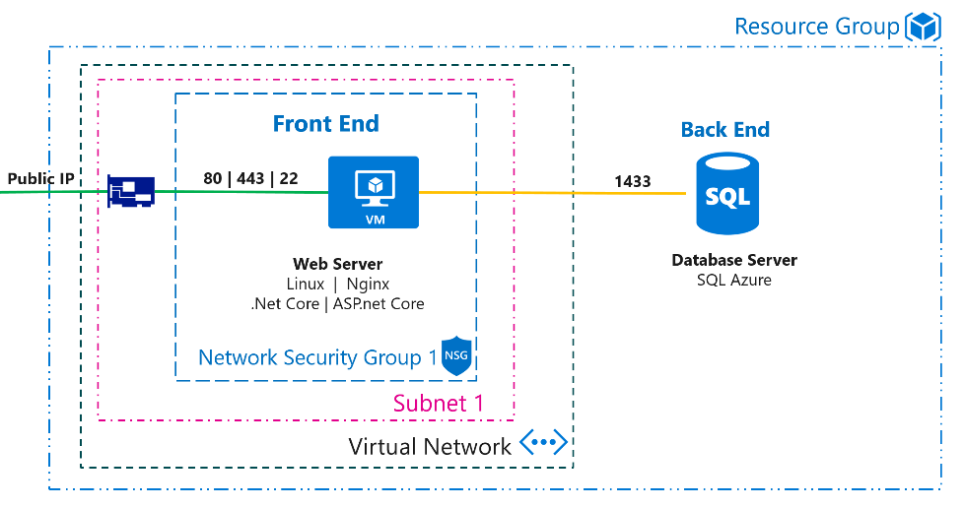
Contoso Offer Solution Template:
There are four main sections in an Azure Resources Manager Template:
Parameters: Customize the deployment by providing values. Values are also defined in and provided by createUIDefinition.
Variables: Construct values that can be used throughout your template.
Resources: Resources used to deploy the Offer (Virtual Network, NSG, VMs and other Azure Services)
Outputs: Returning Values from the deployment

Slide 45
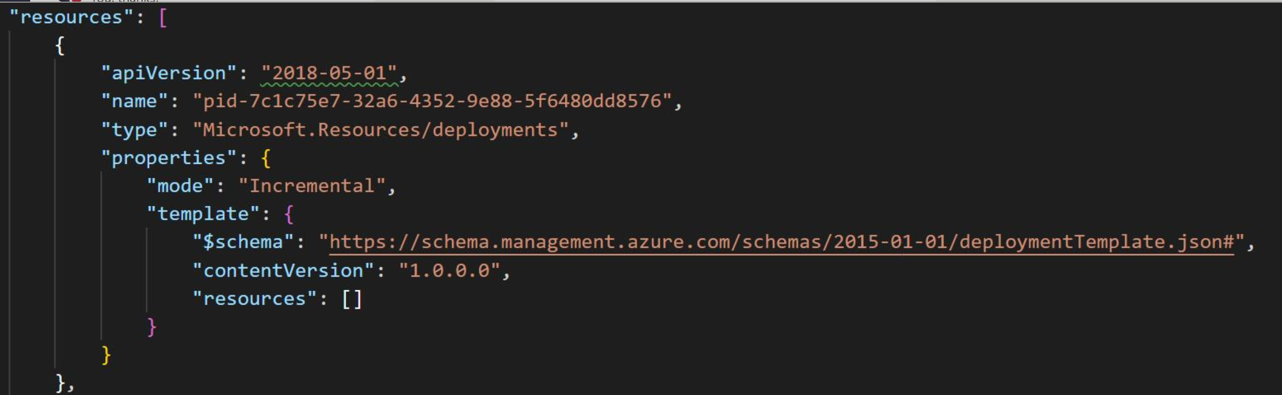
Azure Usage Attribution GUID
1. Generate a GUID
Create a GUID that would unique identify the application.
2. Add GUID To ARM Template
Add the GUID as the First Resource in the Resources section in the Solution Template
https://docs.microsoft.com/en-us/azure/marketplace/azure-partner-customer-usage-attribution

Slide 46
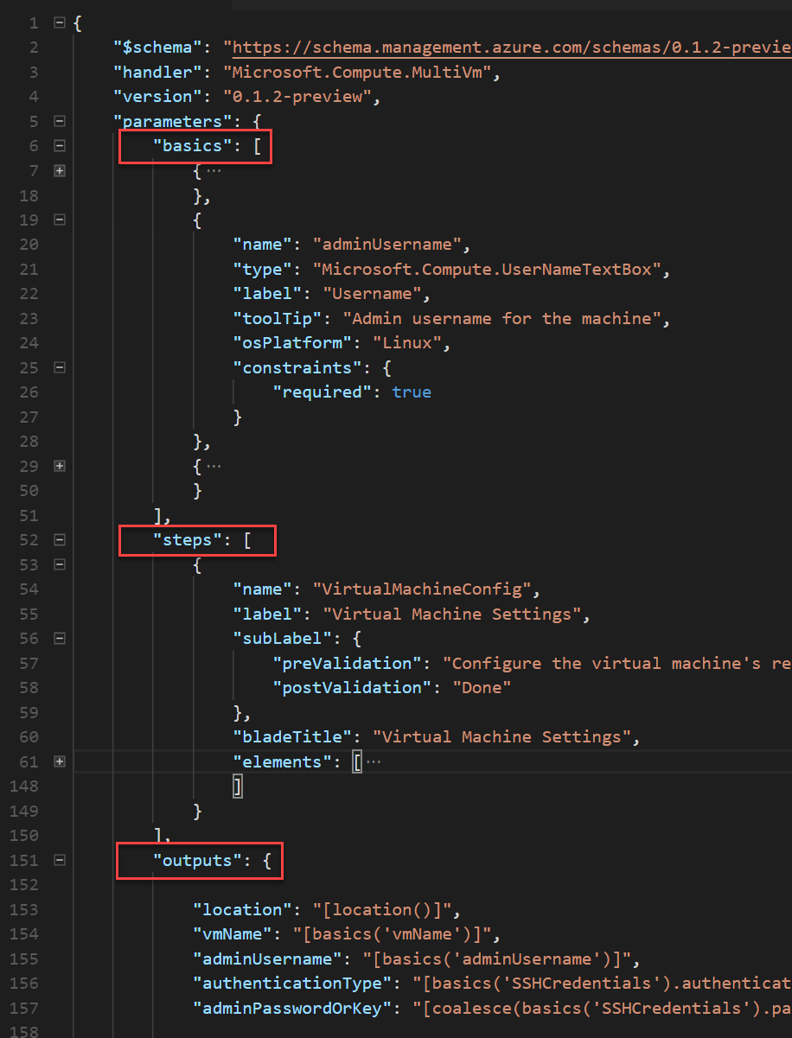
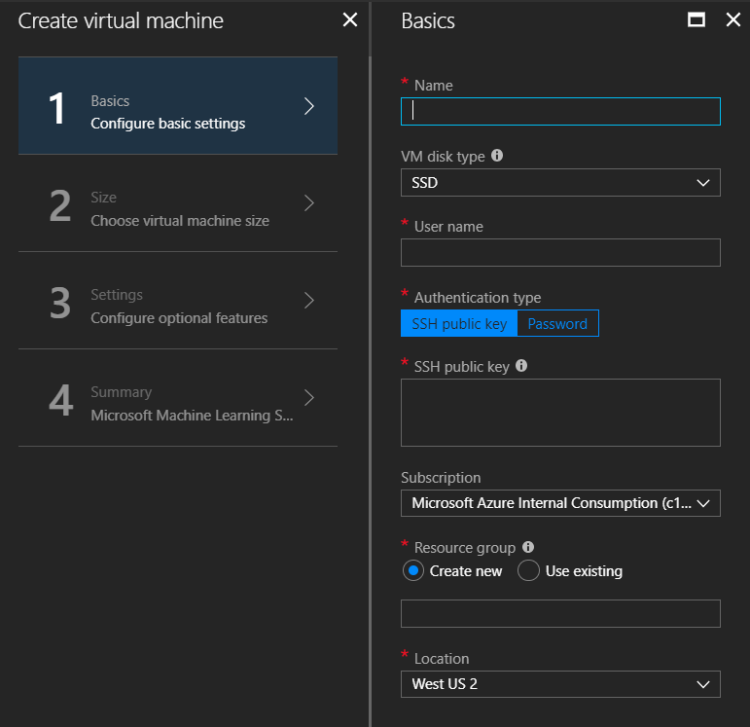
Develop the UI Experience
Create the UI Experience needed for configuring the Offer.
File: createUiDefinition.json
Highly Granular UI definitions
Allows for Multiple “Blades”
Special Types: Upload, Password.

Slide 47
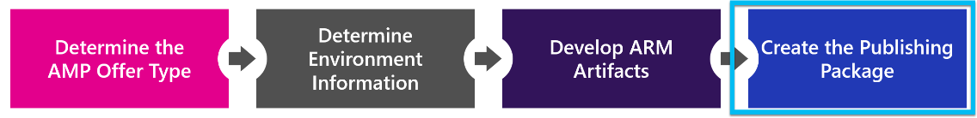
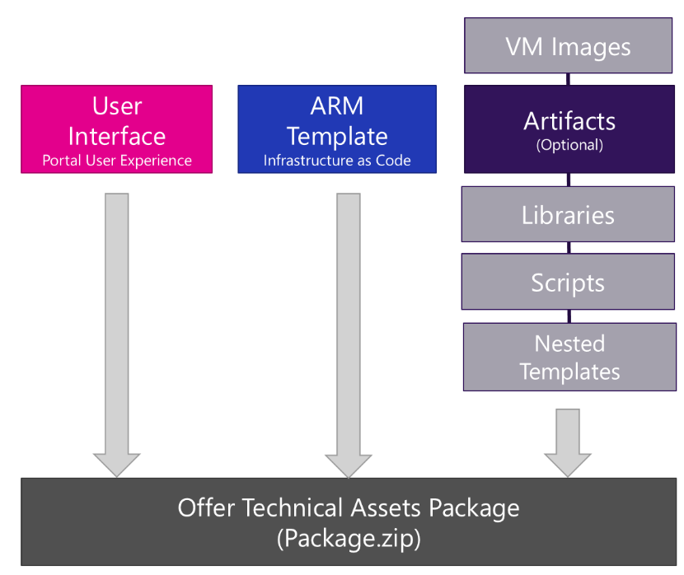
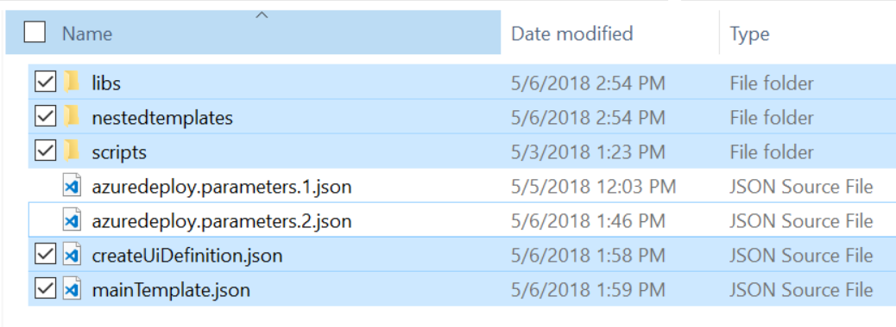
Building the Offer’s package
Minimal Requirements:
mainTemplate.json
createUiDefinition.json
Other Artifacts:
Installation and Configuration Scripts
Libraries, middle tier code needed
Mitigation of Resource Manager Template complexity by using Nested Templates
What not to include:
Parameter Files!
Passwords & SSH Keys (file are public)
SSL Certificates
Casing on the File Names (case Sensitive)
(Mac OS) Zip File Artifacts

Slide 48
Solution Templates Resources and Documentation
Azure Templates Quick Starts | https://github.com/Azure/azure-quickstart-templates
Best Practices | https://github.com/Azure/azure-quickstart-templates/blob/master/1-CONTRIBUTION-GUIDE/best-practices.md
Template Validation Tool | https://github.com/Azure/azure-quickstart-templates/tree/master/test/template-validation-tests
Template Deployment Scripts | PowerShell – https://github.com/Azure/azure-quickstart-templates/blob/master/Deploy-AzureResourceGroup.ps1 Bash – https://github.com/Azure/azure-quickstart-templates/blob/master/az-group-deploy.sh
UI Testing SideLoad Scripts: | PowerShell – https://github.com/Azure/azure-quickstart-templates/blob/master/SideLoad-CreateUIDefinition.ps1 Bash – https://github.com/Azure/azure-quickstart-templates/blob/master/sideload-createuidef.sh
Template Reference Docs | https://docs.microsoft.com/en-us/azure/templates/
CreateUIDefinition Docs | https://docs.microsoft.com/en-us/azure/managed-applications/create-uidefinition-functions
Template Language Expressions | https://docs.microsoft.com/en-us/azure/azure-resource-manager/resource-group-template-functions
Azure PowerShell | https://docs.microsoft.com/en-us/powershell/azure/install-azurerm-ps?view=azurermps-5.7.0
Azure CLI | https://docs.microsoft.com/en-us/cli/azure/?view=azure-cli-latest
Visual Studio Code Extension | https://marketplace.visualstudio.com/items?itemName=msazurermtools.azurerm-vscode-tools

Slide 49
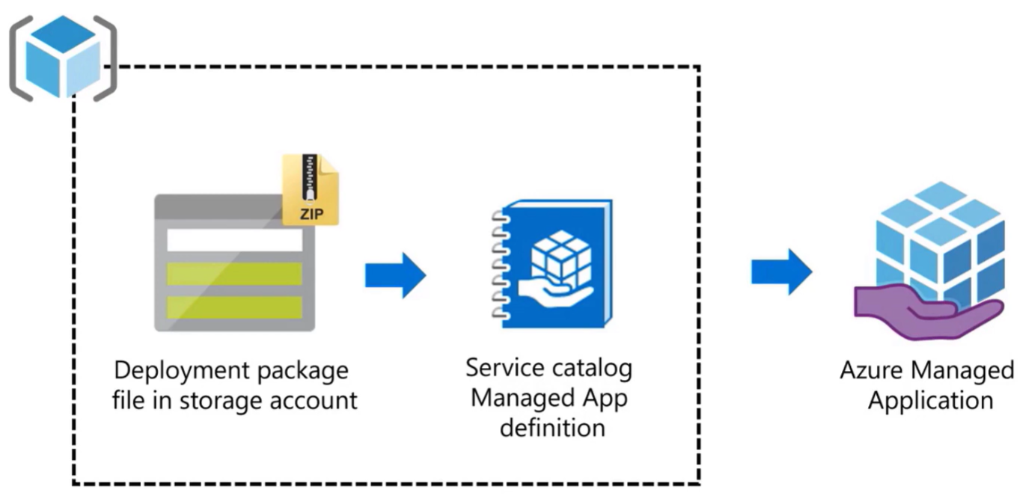
Managed Application Deployment Model
External
Use for public offers
Publish/update the applications definitions through marketplace publishing portal
Deployed via Azure Marketplace
Internal
User for enterprise deployment
AAD tenant publishes/updates the managed applications definitions themselves
Deployed via Service Catalog

Slide 50
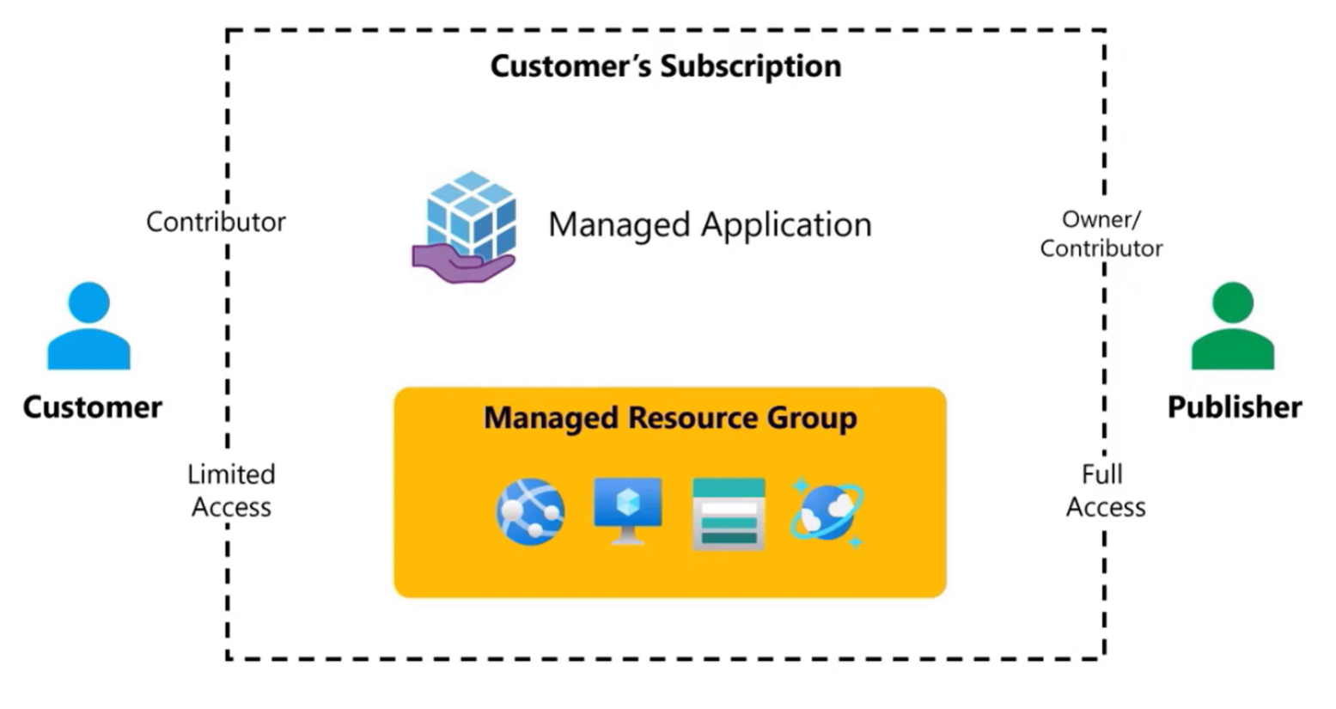
Permission

Slide 51
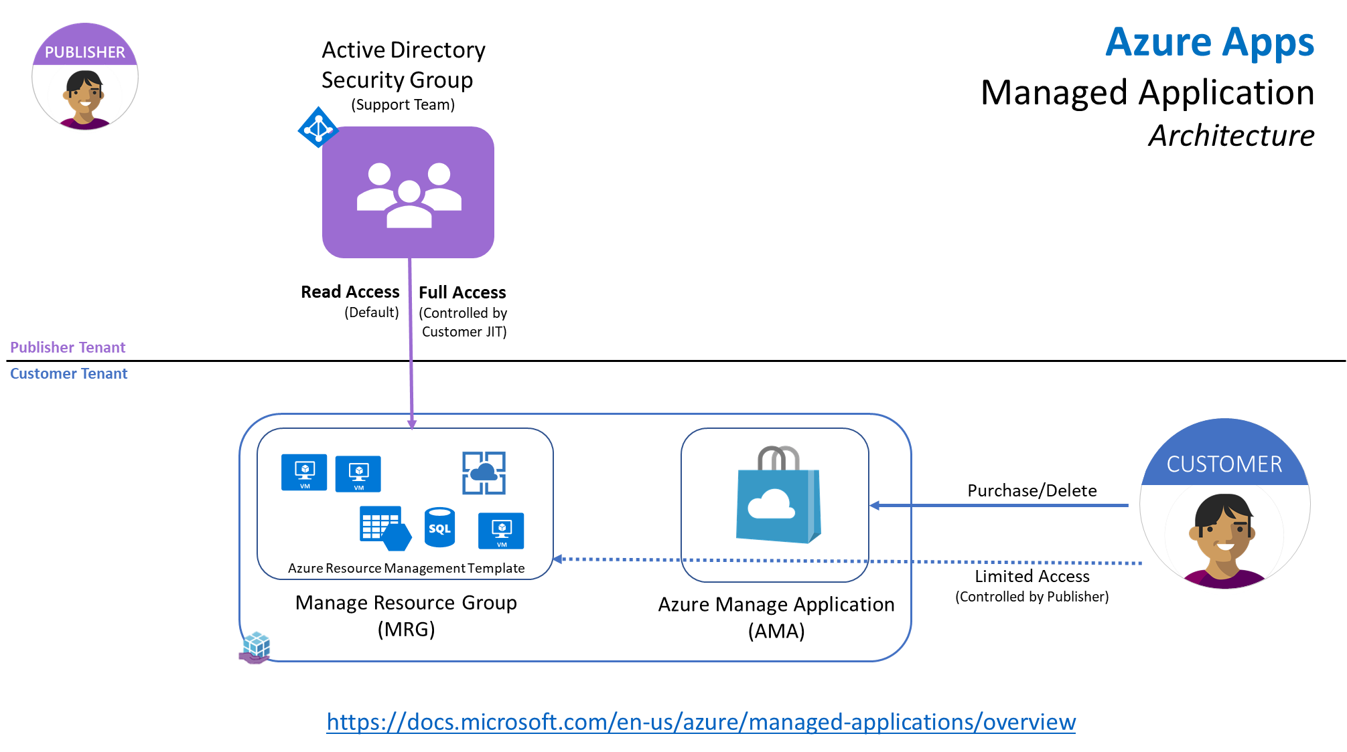
Tenancy and isolation

Slide 52
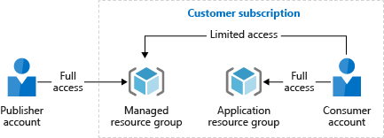
Why to use a Managed Application
Manage specific customer permissions on resources created in their subscription
Change management: Control environment updates
Enable very different deployments based on different plans
Protect IP on a Virtual Machine

Slide 53
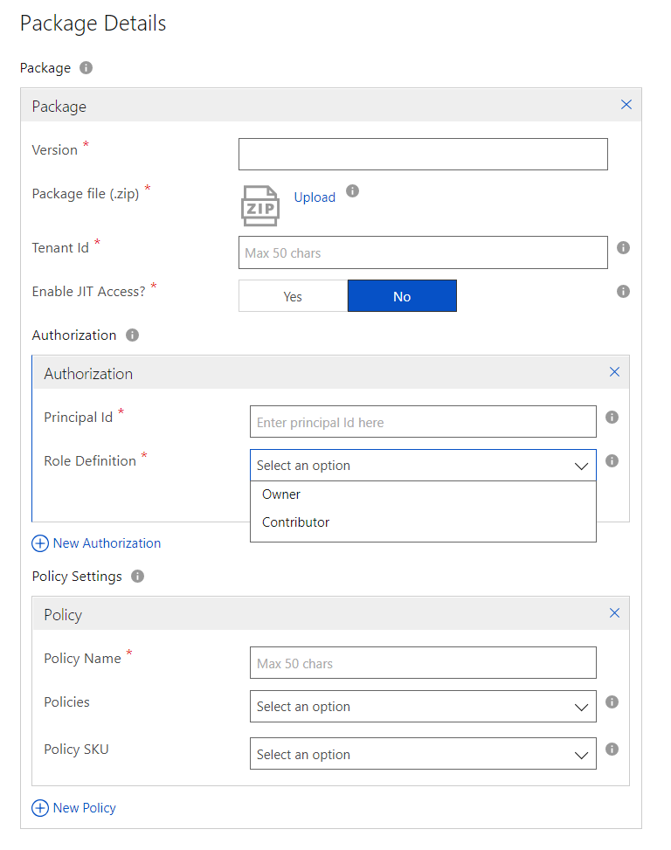
Azure Apps – Managed Application Requirements
Create a Service Principal The Service Principal will be used to managed the ResourceGroup in which the offer will be deployed (in the Customer Subscription). This service Principal
Define the Policy Settings You apply policies to make sure deployed instances of your managed application fulfill data and security requirements.
Enable JIT Access Enable Just-In-Time management access for customer deployments using this offer? CreateUiDefinition.json file must be updated to support this. Security Feature for VMs – Locks Down Traffic.

Slide 54
Managed Application deployment package
application.zip package file
ARM file creates Azure resources
mainTemplate.json
Feeds output to ARM file
Customizes installation screens for users
createUiDefinition.json
viewDisplay.json
Customizes the Managed Application

Slide 55
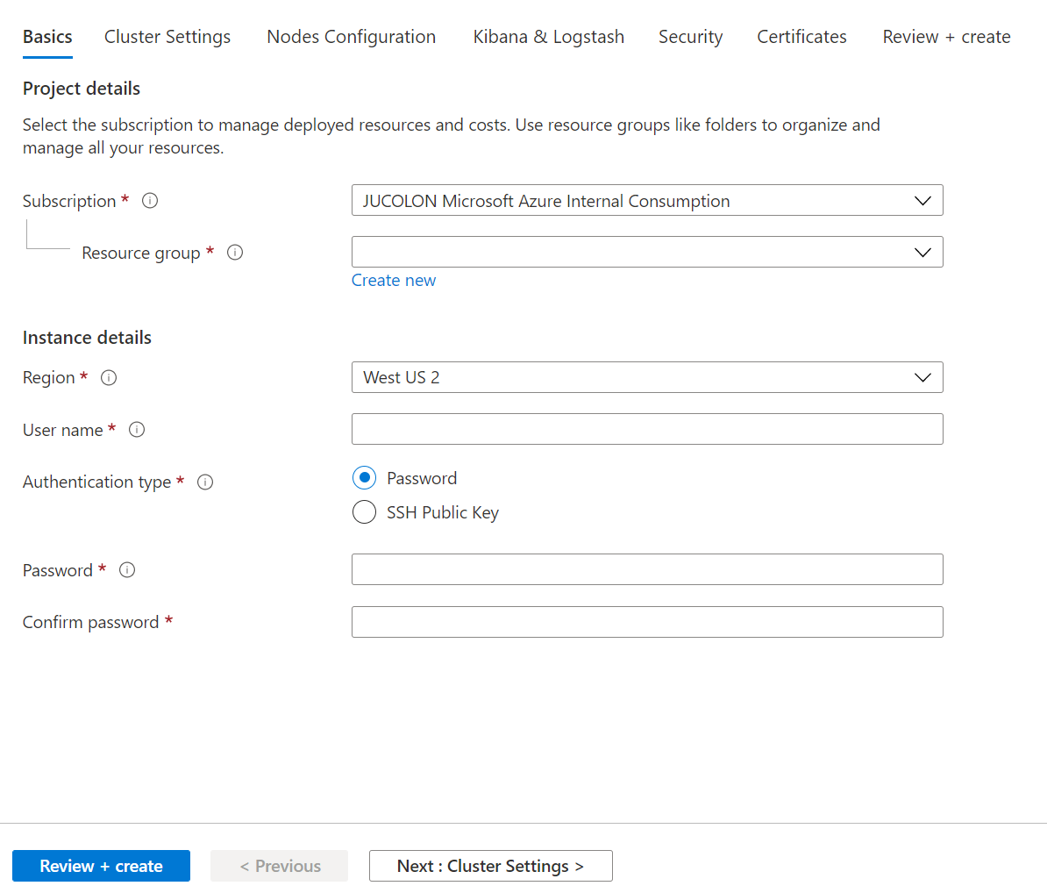
CustomUIDefinition

Slide 56
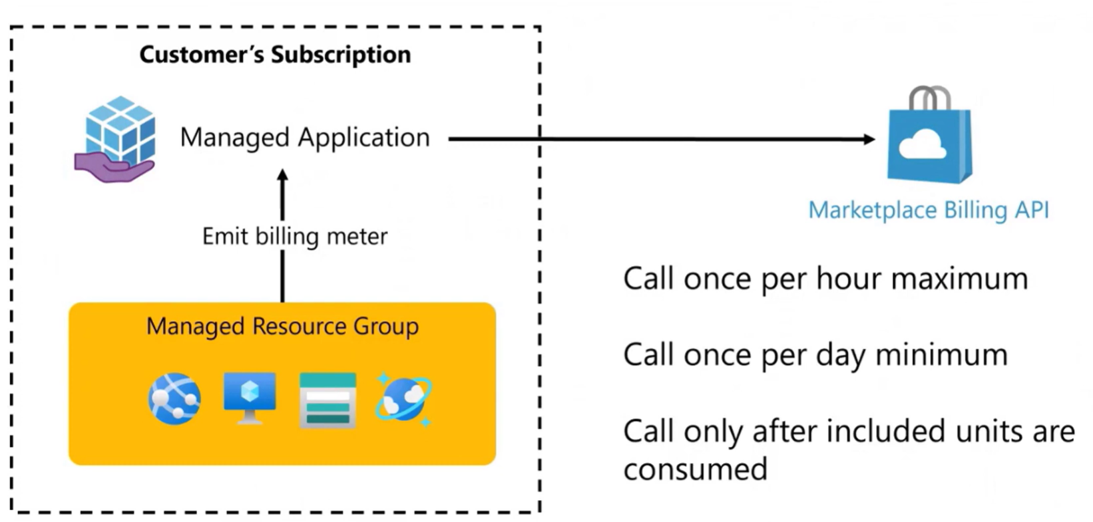
Metered Billing from the Managed Resource Group

Slide 57
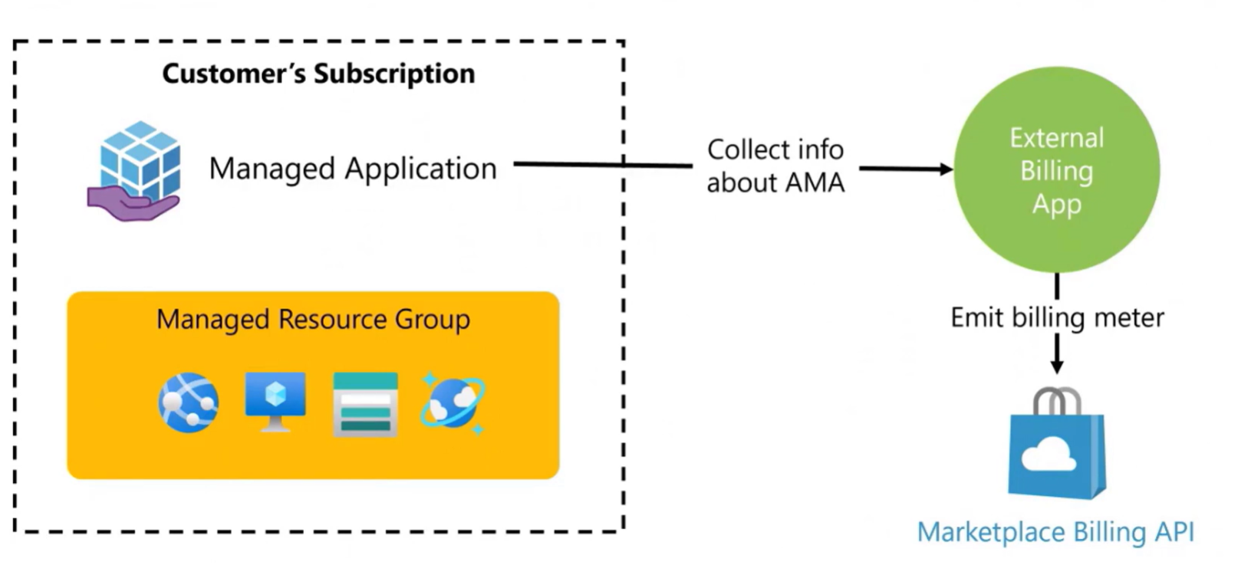
Metered Billing External to the Managed RG

Slide 58
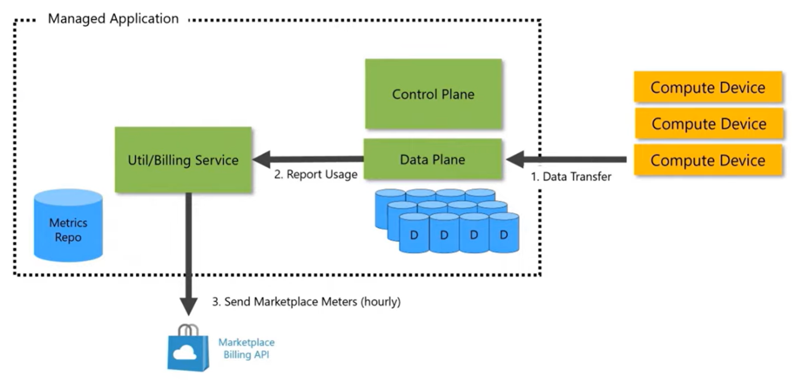
Advanced Scenario – Storage Provider

Slide 59
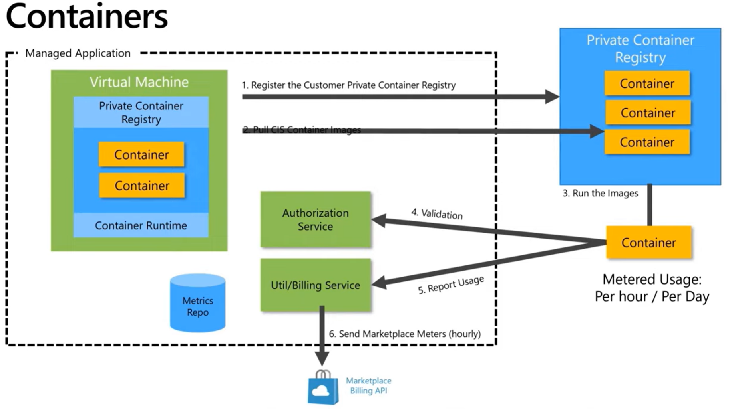

Slide 60
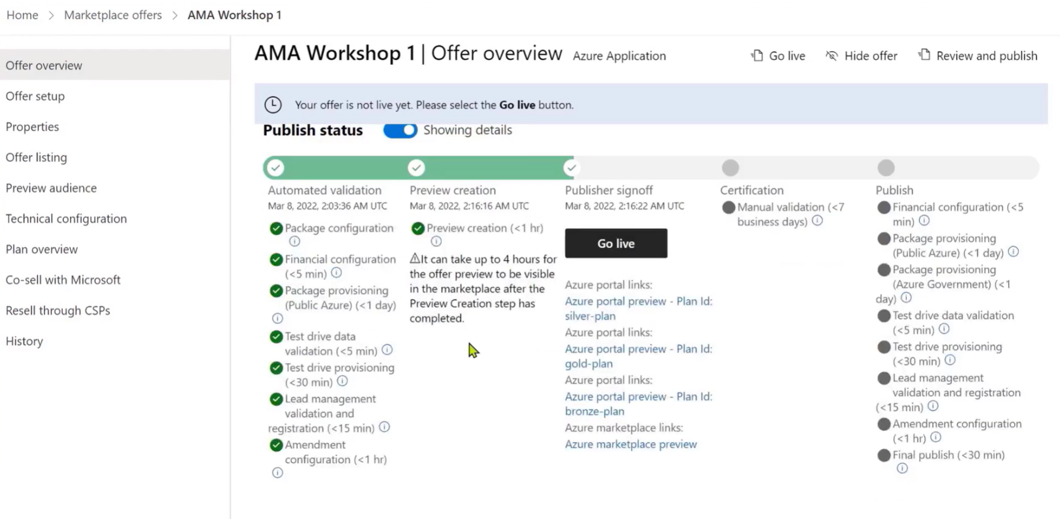
Publishing the Offer

Slide 61
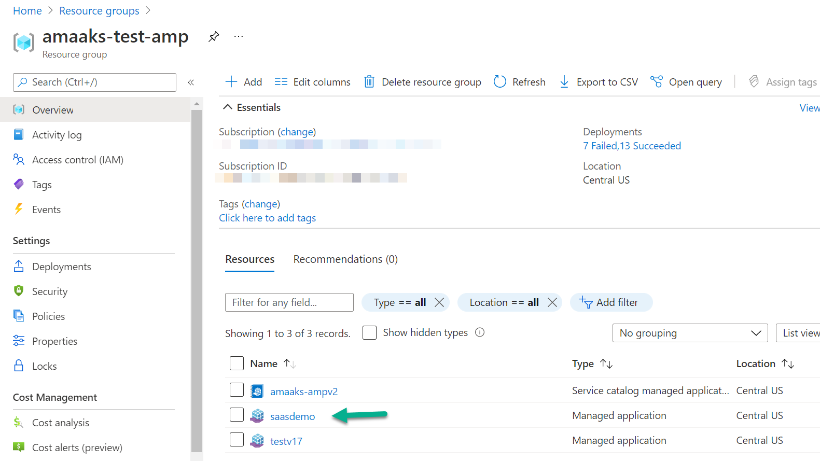
Once Deployed (Buyers View)

Slide 62
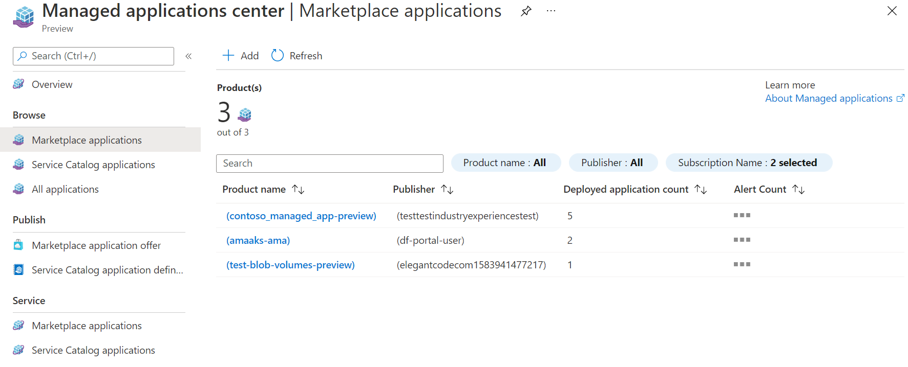
Publishers’ View

Slide 63
Resources
Publishing guide for Azure Applications solution template offers
https://docs.microsoft.com/en-us/azure/azure-resource-manager/managed-applications/overview
VS Code ARM Extension
https://marketplace.visualstudio.com/items?itemName=msazurermtools.azurerm-vscode-tools
Custom UI Sandbox
https://portal.azure.com/?feature.customPortal=false#blade/Microsoft_Azure_CreateUIDef/SandboxBlade
Marketplace ARM Example
https://github.com/Azure/azure-quickstart-templates/tree/master/demos/100-marketplace-sample
https://github.com/Azure/azure-managedapp-samples
https://github.com/microsoft/commercial-marketplace-managed-application-metering-samples

Slide 64
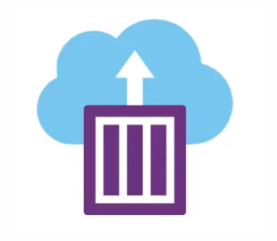
Azure Container offer for Kubernetes app
An offer type in the Azure Marketplace
Allows running your containerized solution on Azure Kubernetes Services (AKS)
Run your solution on the customer’s tenant
Billed through Microsoft (transactable)

Slide 65
Advantages of Azure Container offers
Publishers
Customers
Easy and reusable packaging, CI/CD pipeline integration
Self-serve from marketplace
Security scans and vulnerability/validation checks
One-click deployments
Usage and billing
Publish offers quickly
Transactable offers
Safe and secure

Slide 66
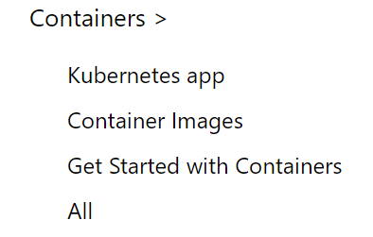
Browsing the Azure marketplace
Transactable
Not transactable

Slide 67






Container offer development lifecycle
Create custom image(s)
Helm chart
& manifest
UX definition & ARM
Package using CNAB
Upload to ACR
Partner Center
Contains your solution
Solution packaging files
For the deployment experience
Package your container(s) into CNAB bundle
Upload the CNAB to your ACR
Reference CNAB image in Partner Center
CNAB = Cloud Native Application Bundle

Slide 68



Package artifacts
Docker image(s)
mainTemplate.json
createUIDefinition.json
Microsoft CNAB bundler container
CNAB bundle (image)
manifest.yaml
mcr.microsoft.com/
container-package-app
Helm chart folder
container packaging tool helping to create the CNAB bundle

Slide 69
Docker images
Package artifacts
One or more images for your solution
Holds your proprietary application code
Uploaded to your own ACR
Docker image(s)
mainTemplate.json
createUIDefinition.json
manifest.yaml
Helm chart folder

Slide 70
mainTemplate.json
Package artifacts
An ARM template
Infrastructure as code
Docker image(s)
mainTemplate.json
createUIDefinition.json
manifest.yaml
Helm chart folder

Slide 71
createUIDefinition.json
Package artifacts
Defines the installation experience for the customer
Similar to a “wizard” for installing the offer
Choose from many components to build the experience
Provides parameters to mainTemplate.json
Docker image(s)
mainTemplate.json
createUIDefinition.json
manifest.yaml
Helm chart folder

Slide 72
manifest.yaml
Package artifacts
Describes the package
Points to other artifact locations
Required by the CNAB bundling tool
Uses semantic versioning to version the CNAB
Docker image(s)
mainTemplate.json
createUIDefinition.json
manifest.yaml
Helm chart folder

Slide 73
Helm chart
Package artifacts
Deployment package for Kubernetes
Helm chart consists of the following
Chart.yaml
values.yaml
templates folder *
* Templates folder contains K8s deployment files
Docker image(s)
mainTemplate.json
createUIDefinition.json
manifest.yaml
Helm chart folder

Slide 74
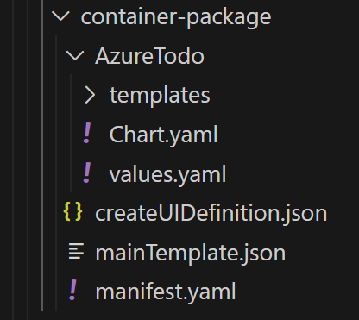
An example solution
K8s template files
Helm files
Deployment files
CNAB file

Slide 75

Publication process overview

Slide 76



The SaaS Offer
CUSTOMER
SaaS Offer
Let you bring and sell your Software as a Service solutions
Azure Marketplace
SaaS Offer Properties
The SaaS Offer is deployed in the Publisher Subscription
SaaS Offer provides:
Four Billing options:
Per month and per year
Per seat
Metered.
Four publishing options:
Contact Me
Free
Free Trial
Transact
SaaS Offer

Slide 77



SaaS Offer Transact Requirements
Offer’s Landing Page
1. Offer’s Landing Page Landing Page to send customers to register for the service and complete the service configuration
Offer’s Azure AD Registration
2. Register the Customer Registration Service with Azure AD The Registration and Billing Implementation services need to be registered with Azure AD in advance to authenticate against the Marketplace billing API. Use the Azure AD TenantID + AppID to Generate the JWT token each API Call
Offer’s SaaS Application
3. Implement the Customer Provisioning, Plan Management and Marketplace Billing API & a Webhook Implement the Marketplace Billing API Calls and a Webhook service to respond to Marketplace Notification (Actions to Notify the SaaS Offer. Need to Provide a Webhook endpoint

Slide 78



SaaS Offer Experience: Transact/Sell through Microsoft
Azure AD
Azure Portal
5
5.1 Subscribe: Select Name, Subscription, Resource Group, Resource Group Location and the Offer’s Plan
5.2 Offer Gets Created + Email Sent to Customer to Configure Account
5.3 Click Configure Account: Customer Gets Redirected to Offer’s Landing Page
Validate Identity
4
7
Offer’s Landing Page
Landing Page + Billing Token
Validate Identity
3
Create Offer
6
Get Billing Service Token
2
Azure Marketplace
8
CUSTOMER
Offer’s SaaS Application
Marketplace
Billing Service
1
Redirected To App.
Purchase Offer
* Sell Through Microsoft

Slide 79




SaaS Service Provisioning
Azure Portal
SaaS Offer Components
URI: Landing Page + Billing Token
1
Offer’s Landing Page
6
Marketplace Token: https://admin.healthbot.microsoft.com/saas?token=asdfasd...
Sign Up Customer
Register and store: Customer Info, Unique SaaS Offer SubscriptionId, Plan, etc.
Retrieve Customer Azure AD Info.
Azure AD
2
Offer’s Billing Service & WH
7
Get SaaS Offer JWT Token.
Requires: SaaS offer to be registered with Azure AD
3
Provision the Service
Configure and Provision the Service for this user.
Confirm the selected Plan and send the request to Activate the Plan to the Marketplace Billing API to start the Billing.
POST: /saas/subscriptions/resolve
Billing Token + Azure AD JWT Token
Marketplace
Billing
Service
API
4
Offer’s SaaS Application
Response: Unique SaaS Offer SubscriptionId, OfferId, PlanId, Quantity, & OperationId
5
POST: /saas/subscriptions/activate
Unique SaaS Offer SubscriptionId + Azure AD JWT Token
8

Slide 80

https://aka.ms/marketplacesamples

Slide 81



Slide 82


Slide 83

After creation

Slide 84

Email

Slide 85

SaaS resources

Slide 86


Slide 87


Slide 88


Slide 89


Slide 90


Slide 91


Slide 92
SaaS Subscription’s States
State | Description
Provisioning | Provisioning of the SaaS Subscription
Provisioned | This is the steady state of a provisioned service
Provisioning for Update | Provisioning of the SaaS Subscription Update (Up a plan, Down a Plan). Two calls: Microsoft initiates the call ISV initiates the call
Suspended | This state is used to indicate that a customer’s due payment has not been received
Unsubscribed | This state is used to indicate that a customer request the subscription to be suspended or that the account has been unsubscribed because they have not payed their dues
Data Deleted | Customer data is delete after a data retention time has expired

Slide 93
Lifecycle of an AMP SaaS Subscription
Provisioning for update (Fulfilment Pending)
CSP – reinstate
Update (licenses, convert)
CSP – on behalf purchase
CSP - signals not paid
Suspended (Suspended) ==in grace
ISV ack (success/failed)
Microsoft dues not paid
On timer (30 day)
Provisioned (Fulfilment Pending)
Provisioned (Fulfilment Complete)
Activate
Microsoft dues paid
Unsubscribed (Unfulfilled) ==data retention starts
Customer purchase
Customer unsubscribe
Data deleted
On timer (ISV driven)

Slide 94


Sample Landing Page

Slide 95

Sample Landing Page

Slide 96


Slide 97


Slide 98

Metered Billing

Slide 99
Transactable SaaS offer tasks
Tasks | Description | Artifact
Register Customer | Register/Provision a customer for the selected SaaS Offer | Web App.
Assign a Plan | Assign the customer the selected Plan/SKU for the Offer | Web App.
Activate the Billing for an Offer’s subscription | Tell the Marketplace e-commerce engine to start billing the customer for the select plan | API Call
Operations for Plan Management | API operations to manage the Offer public and Private Plans. Upgrade, Downgrade, and plan information. | API Call
Operations for Offer Management | API operations to manage the LiveCycle of the Offer. | API Call
Fulfillment API v2: https://docs.microsoft.com/en-us/azure/marketplace/partner-center-portal/pc-saas-fulfillment-api-v2
Metered API: https://docs.microsoft.com/en-us/azure/marketplace/partner-center-portal/marketplace-metering-service-apis

Slide 100


Creating a SaaS offer in Partner Center
Partner Center
2
Marketplace Offer
Partner
Provide Offer’s Information
1
3
Create Offer’s Plans/SKUs
Create Offer
4
Provide Offer’s Technical
Information

Slide 101


Slide 102

SaaS Offer: Technical configuration (transact)
Transact Only
Landing Page URL
Connection Webhook
Azure AD Tenant ID
Azure AD Application ID

Slide 103

Publish the Offer

Slide 104
SaaS offer Billing Models
Pricing Option | Description
Per Month | Month to Month Billing
Per Year | Per year-based billing.
Per Seat | Bill customers per number of seats/devices/users utilized. It provides the ability to define a Maximum and Minimum
Metered – Variable | Billing using custom meters. Publishers can define up to 18 dimensions per Plan
Metered – Fix + Variable | Billing using a combination of Fix price and customer meters. Publishers can define up to 18 dimensions per Plan
Metered - Fix + Variable + Setup Fees | Combination of a fixed price and multi-dimension-based consumption + Installation/Setup fees (One Time usage for this dimension)
Metered - Fix + Variable + Setup Fees + Maintenance Contract | Combination of a fixed price and multi-dimension-based consumption + Installation/Setup fees + Maintenance Contract

Slide 105
SaaS offer Pricing Examples: Per Month/Year
Pricing Option | Description | Example Plans for an Offer
Flat Rate – Monthly | Monthly Flat Rate, Multiple Plans Allowed | Plan 1 – Basic $100/month Plan 2 – Premium $200/month
Flat Rate – Yearly | Yearly Flat Rate, Multiple Plans Allowed | Plan 1 – Basic $1200/Year Plan 2 – Premium $2400/Year
Combination of Billing Terms | For a Single Plan, you can combine the billing Terms (Monthly, Annual) | Plan 1 – Basic: $100/Month $1000/Year (– $200 discount) Plan 2 – Premium: $200/Month $2400/Year ( – $400 discount)

Slide 106
SaaS offer Pricing Examples: Per Seat
Pricing Option | Description | Example Plans for an Offer
Per Seat – Monthly | Seat Base Billing, Multiple Plans Allowed. Can be Per Month or Per Year | Plan 1 – Basic $5/month/Seat Plan 2 – Premium $10/month/Seat
Per Seat – Annual | Seat Base Billing, Multiple Plans Allowed. Can be Per Month or Per Year | Plan 1 – Basic $60/year/Seat Plan 2 – Premium $120/year/Seat
Combination of Billing Terms | For a Single Plan, you can combine the billing Terms (Monthly, Annual) | Plan 1 – Basic: $5/Month $50/Year (– $10 discount) Plan 2 – Premium: $10/Month $100/Year ( – $20 discount)

Slide 107
SaaS offer Pricing Examples: Per Seat
Seat Base Billing, multiple SKU (Plans) Allowed. Can be Per Month or Per Year
Pricing Option | Description | Example Plans for an Offer
Without Upper Limit | Per seat pricing without any upper limits. Per Seat pricing remains the same independently of how many seats are purchased | Plan 1 – Basic – $6/month/Seat Plan 2 – Premium $1200/month/Seat
Same Upper Limit | Per seat pricing with the same upper limits. Per Seat pricing remains the same independently of the seats purchased | Plan 1 – Plan MAX 1K – Up to 1000 Seats $6/month/Seat
Discount based on Seat Volume | Tiered Per seat pricing. Pricing changes based on number of the seats purchased. Requires multi-plan setup | Plan 1 - 1-100 Seats $10/month/Seat Plan 2 - 101-200 Seats $8/month/Seat Plan 3 - 201-300 Seats $6/month/Seat
.

Slide 108
SaaS offer Pricing Examples: Metered
Pricing Option | Description | Example Plans for an Offer
Variable | Consumption based on variable usage | Plan A – Number of Transactions $0.12/transaction
Fix + Variable | Consumption based on a fix amount, plus variable usage | Plan B – Basic $25/Month (2000 transactions included) + $0.10/transaction
Multi-Dimension | Consumption based on multiple dimensions. Up to 18 dimensions allowed | Plan C – Basic - Picture Beautification Service D1 – Picture Sharpening $0.10/unit D2 – Picture Red-Eye Removal $0.10/unit D3 – Picture Resize $0.12/unit D4 – Per Megabit Send $0.25/unit
Multi-Dimension Fix + Variable | Combination of a fixed price and multi-dimension based consumption | Plan D – Basic $10/Month (1000 Pictures Resize/Sharpening/Red-Eye and 100 Megabits) + Picture Processed D1 – Picture Sharpening $0.10/unit D2 – Picture Red-Eye Removal $0.10/unit D3 – Picture Resize $0.12/unit D4 – Per Megabit Send $0.25/unit

Slide 109
SaaS offer Pricing Example: Metered Extended
Pricing Option | Description | Example Plans for an Offer
Fix + Variable + Setup Fees | Combination of a fixed price and multi-dimension-based consumption + Installation/Setup fees (One Time usage for this dimension) | Plan D – Basic $10/Month (1000 Pictures Resize/Sharpening/Red-Eye and 100 Megabits) + Picture Processed D1 – Picture Sharpening $0.10/unit D2 – Picture Red-Eye Removal $0.10/unit D3 – Picture Resize $0.12/unit D4 – Per Megabit Send $0.25/unit D5 – Installation/Setup Fees ($10,000) -> One Time usage of this dimension
Fix + Variable + Setup Fees + Maintenance Contract | Combination of a fixed price and multi-dimension-based consumption + Installation/Setup fees + Maintenance Contract | Plan D – Basic $10/Month (1000 Pictures Resize/Sharpening/Red-Eye and 100 Megabits) + Picture Processed D1 – Picture Sharpening $0.10/unit D2 – Picture Red-Eye Removal $0.10/unit D3 – Picture Resize $0.12/unit D4 – Per Megabit Send $0.25/unit D5 – Installation/Setup Fees ($10,000) -> One Time usage of this dimension D6 – Maintenance Contract ($30/Month) -> Divide per # days/Year ~ $1.00/day/Unit

Slide 110

Monitoring and Maintenance
Monitoring the Offer
Marketplace Provides the following Monitoring/Reporting Capabilities:
Usage
Deployments
Customer trends on the Insights home page
Detailed orders, usage, and customer data
Orders and usage shown as a monthly summary or as a six-month trend view
Usage/orders sliced by several criteria
For more information refer to the Marketplace Publisher Guide document
Offer Maintenance
Partners are responsible for:
Updating their Offer assets on a timely matter when Microsoft sends notifications (from the Agreement)
Having a consistent application uptime
Having a consistent application deployment success rate

Slide 111

Monitoring and Maintenance

Slide 112

Monitoring and Maintenance

Slide 113

Monitoring and Maintenance

Slide 114


Slide 115
Getting started and Marketplace Incentives
ISV Success Program
Marketplace Rewards
Co-sell
Azure IP co-sell incentive
Incentive Program

Slide 116
How to get started

Slide 117

ISV Success
Supporting SaaS and other software providers to build with the Microsoft Cloud and reach more customers through the Microsoft commercial marketplace
Learn more

Slide 118


Slide 119


Slide 120


Slide 121


Slide 122


Slide 123


Slide 125


Slide 127


Slide 128


Slide 130


Slide 131


Slide 132


Slide 133


Slide 134


Slide 135


Slide 136


Slide 137


Slide 138


Slide 139


Slide 140
Marketplace Transact and Grow Incentive Campaign
https://partner.microsoft.com/en-us/asset/collection/marketplace-transact-and-grow-incentive-campaign#/
ISV ACR Growth Incentive Campaign
https://partner.microsoft.com/en-us/asset/collection/isv-acr-growth-incentive-campaign#/

Slide 141
Additional Resources
Documentation
https://aka.ms/marketplacepublisherguide
Customer Document
https://aka.ms/marketplacebuyerguide
Content Library for ISVs
https://www.microsoft.com/en/isv/publishing-to-marketplace
Webinars
https://aka.ms/MTMwebinars
Office hours
https://aka.ms/MTMofficehours
Microsoft Marketplace Resources
https://aka.ms/marketplacesamples
Marketplace Publisher’s forum
https://aka.ms/marketplacepublisherforum
Open a support ticket for assistance
https://aka.ms/marketplacepublishersupport
StackOverflow:
Azure Marketplace
Azure Resource Manager
SaaS Accelerator
https://github.com/Azure/Commercial-Marketplace-SaaS-Accelerator
Marketplace Incentive Guide
Marketplace Transact And Grow Incentive Campaign (microsoft.com)

Slide 142
Thank you.

